Slide 1



Report Usage Metrics Report
View in Power BI
Last data refresh:
10/13/2017 1:05 PM UTC
Downloaded at:
10/13/2017 2:48 PM UTC

Slide 2
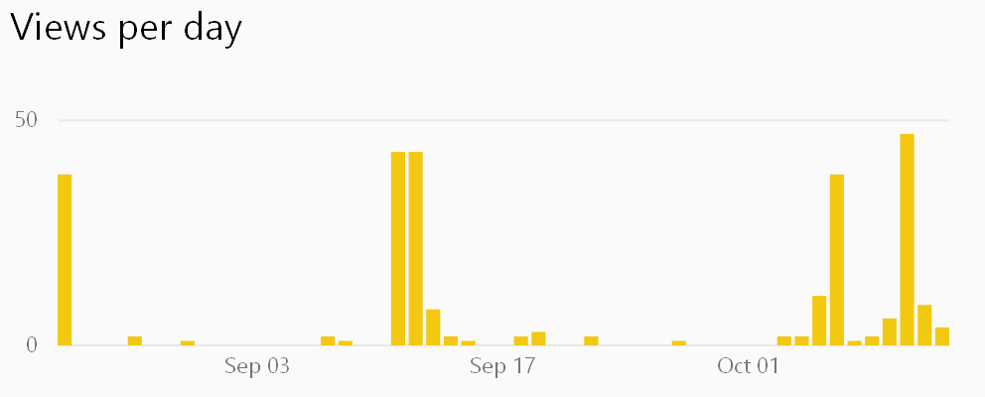
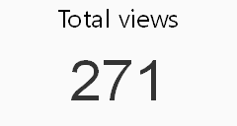
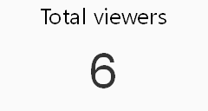
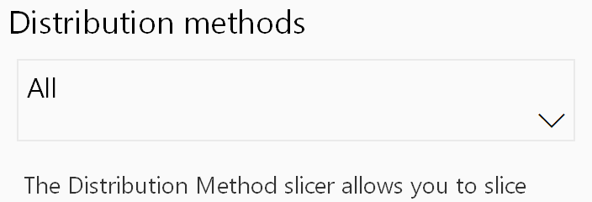
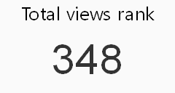
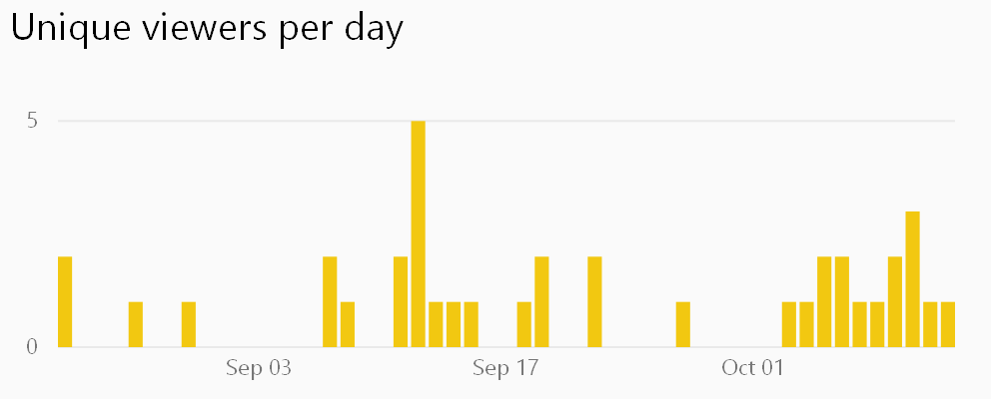

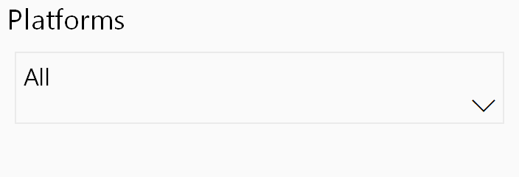
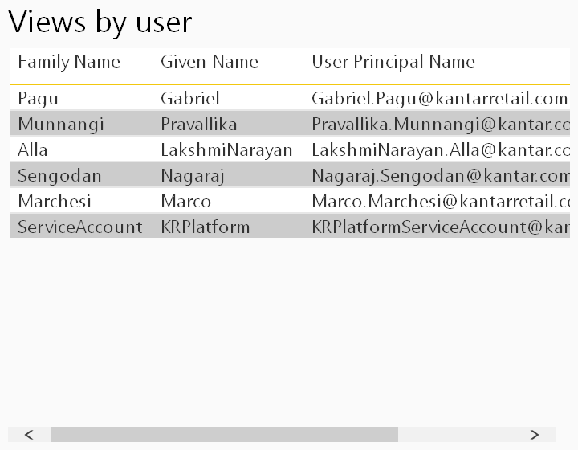
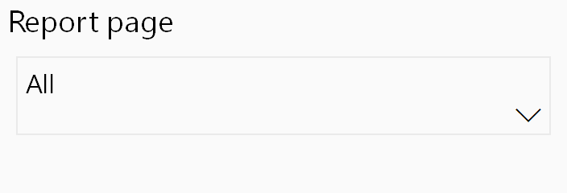
Report Usage Metrics
This report is automatically generated by Power BI to provide usage metrics for your report. Usage data is retained for the last 90 days. Changes to your report may take up to 24 hours to appear here. Learn more
Rank is calculated by comparing this report against other reports in your organization. Learn more
The Distribution Method slicer allows you to slice based on how the user obtained access to this report. Learn more

